Slide 1







These functions, U, H, F and G are collectively called Thermodynamic Potential
- TS
U | F
H | G
$$U−TS=F$$
$$U−TS+PV=G$$
$$F+PV+TS=H$$
+PV
$$H−TS=G$$
$$G+TS−PV=U$$
$$U+PV=H$$
$$F+PV=G$$

Slide 2

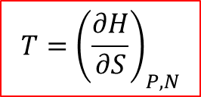
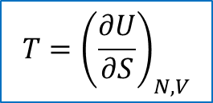





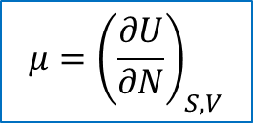
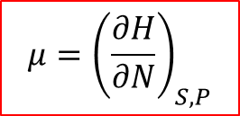

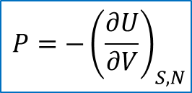

Thermodynamic Identities
Remember, 1st Law
$$dU=TdS−PdV+μdN$$
As $U=U(S,V,N)$
$${T=\left(\frac{∂U}{∂S}\right)}_{N, V}$$
$${P=−\left(\frac{∂U}{∂V}\right)}_{S, N}$$
$${μ=\left(\frac{∂U}{∂N}\right)}_{S, V}$$
We can get similar relations from S(U, V, N)
We can also find similar relationship of thermodynamic identities from Enthalpy H, Helmholtz Free Energy F and Gibb’s Free Energy G.
Enthalpy
$$H=U+PV$$
➔ $dH=dU+PdV+VdP$
$dH=\left(Tds−PdV+μdN\right)+PdV+VdP$
$$dH=TdS+VdP+μdN$$
-- (1)
Hence, $H=H(S,P,N)$
➔ $dH={\left(\frac{∂H}{∂S}\right)}_{P, N}dS+{\left(\frac{∂H}{∂P}\right)}_{S, N}dP+{\left(\frac{∂H}{∂N}\right)}_{S, P}dN$
----------- (2)
Comparing Eq(1) and (2)
$${T=\left(\frac{∂H}{∂S}\right)}_{P, N}$$
$${V=\left(\frac{∂H}{∂P}\right)}_{S, N}$$
$${μ=\left(\frac{∂H}{∂N}\right)}_{S, P}$$

Slide 3

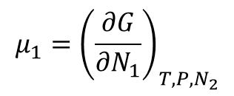









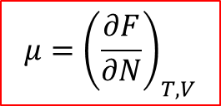
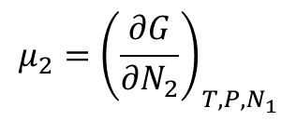
Helmholtz Free Energy
$$F=U−TS$$
➔ $dF=dU−Tds−SdT$
$$dF=(TdS−PdV+μdN)−Tds−SdT$$
$$dF=−SdT−PdV+μdN$$
----- (3)
Therefore, F = F(T, V, N)
➔ $dF={\left(\frac{∂F}{∂T}\right)}_{V, N}dT+{\left(\frac{∂F}{∂V}\right)}_{T, N}dV+{\left(\frac{∂F}{∂N}\right)}_{T, V}dN$
--------- (4)
Comparing Eq (3) and (4)
➔
$${P=−\left(\frac{∂F}{∂V}\right)}_{T, N}$$
$${μ=\left(\frac{∂F}{∂N}\right)}_{T, V}$$
$${S=−\left(\frac{∂F}{∂T}\right)}_{V, N}$$
Similarly for Gibb’s Free Energy
P: 5.8
$${S=−\left(\frac{∂G}{∂T}\right)}_{P, N}$$
$${V=\left(\frac{∂G}{∂P}\right)}_{T, N}$$
$${μ=\left(\frac{∂G}{∂N}\right)}_{T, P}$$
If there are more than one type of particles involved
$${μ_{1}=\left(\frac{∂G}{∂N_{1}}\right)}_{T, P, N_{2}}$$
$${μ_{2}=\left(\frac{∂G}{∂N_{2}}\right)}_{T, P, N_{1}}$$
. . .

Slide 4
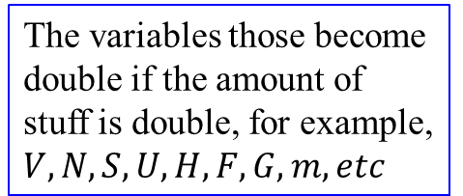
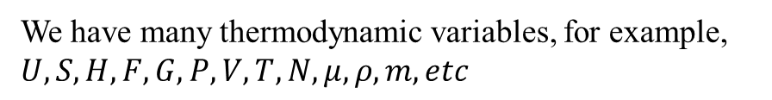
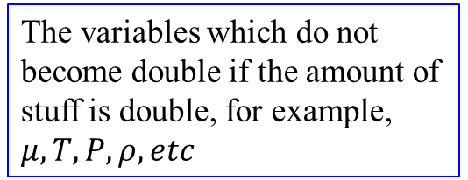
Conclusion
We have many thermodynamic variables, for example, $U, S, H, F, G, P, V, T, N, μ, ρ, m, etc$
They can be divided into two categories
Extensive Variables
Intensive Variables
The variables those become double if the amount of stuff is double, for example, $V, N, S, U, H, F, G, m, etc$
The variables which do not become double if the amount of stuff is double, for example, $μ, T, P, ρ, etc$

Slide 5
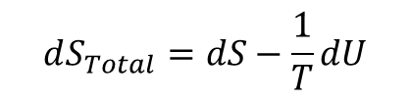





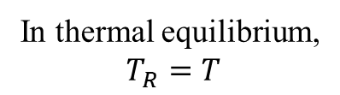
Free Energy is a Force towards Equilibrium
We know for an isolated system $∆S≥0$
➔ The system’s entropy governs the direction of spontaneous change
What if a system is not isolated?
Suppose that a system is in good thermal contact with environment
The system can exchange energy with environment
Now we can not say that system’s entropy tends to increase
But we can say
As environment can be considered as an ideal reservoir – can absorb or release heat without changing its temperature
$$dS_{Total}≥0$$
We also know
$$dS_{Total}=dS+dS_{R}$$
---------- (1)
$$dU=Tds−PdV+μdN$$
➔ $dS=\frac{1}{T}dU+\frac{P}{T}dV−\frac{μ}{T}dN$
---------- (2)
For a reservoir, if V and N remain constant
$dS_{R}=\frac{1}{T_{R}}dU_{R}$ and ${dU}_{R}=−dU$
----- (3)
In thermal equilibrium,
$T_{R}=T$
$$dS_{Total}=dS−\frac{1}{T}dU$$
Eq (1) ➔
---------- (4)

Slide 6
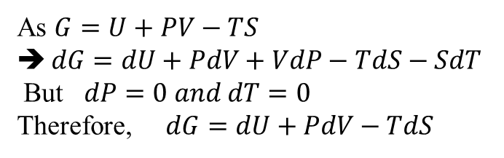
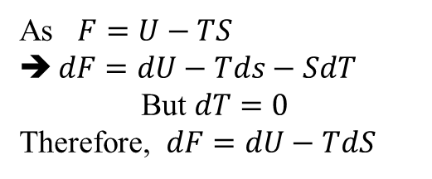
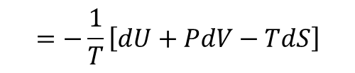
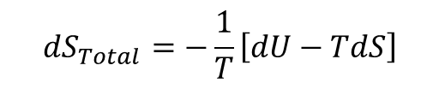
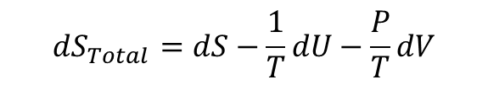
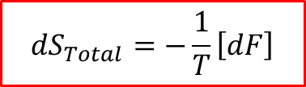

$$dS_{Total}=−\frac{1}{T}\left[dU−TdS\right]$$
As $F=U−TS$
$dF=dU−Tds−SdT$
But $dT=0$
Therefore, $dF=dU−TdS$
$$dS_{Total}=−\frac{1}{T}\left[dF\right]$$
Condition: T, V and N are fixed (constant)
An increase in total entropy results in decrease of Helmholtz Free Energy of the system
To achieve thermal equilibrium, F must be minimum
What about the case, when P, T and N are fixed instead of V, T and N ?
Now we will have
$$dU_{R}=−dU and dV_{R}=dV while dN=0$$
Eq (2) ➔
$$dS_{Total}=dS−\frac{1}{T}dU−\frac{P}{T}dV$$
$$=−\frac{1}{T}\left[dU+PdV−TdS\right]$$
As $G=U+PV−TS$
$dG=dU+PdV+VdP−TdS−SdT$
But $dP=0 and dT=0$
Therefore, $dG=dU+PdV−TdS$
$$dS_{Total}=−\frac{1}{T}\left[dG\right]$$
For fixed P, T and N
Increase in total S results decrease in Gibb’s Free Energy of the system

Slide 7
Summary
Note: N is fixed (constant) in all following cases
Isolated system U and V are fixed → S of the system tends to increase
For non-isolated system
Thermal equilibrium with environment
T and V are fixed → F of the system tends to decrease
Thermal and Mechanical equilibrium with environment
P and T are fixed → G of the system tends to decrease
Entropy of the environment can increase in two ways:
Environment can absorb energy from the system, U of the system decreases
OR
It can acquire volume from the system, V of the system decreases
This will assure, maximizing the entropy of the universe

Slide 8



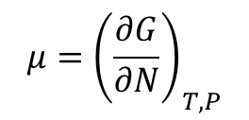
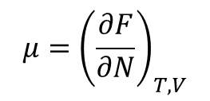
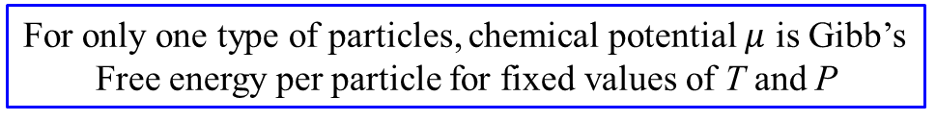

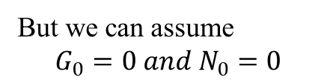
Gibb’s Free energy and Chemical Potential
$${μ=\left(\frac{∂G}{∂N}\right)}_{T, P}$$
We know
G is Extensive$\text{, }\text{while}μ$ is Intensive
If N is increased
➔ G will increase
$$G=μN$$
New interpretation to chemical potential
For only one type of particles, chemical potential $μ$ is Gibb’s Free energy per particle for fixed values of T and P
Actually, $∆G=μ∆N$
➔ $G−G_{0}=μ\left(N−N_{0}\right)$
But we can assume
$$G_{0}=0 and N_{0}=0$$
$${μ=\left(\frac{∂F}{∂N}\right)}_{T, V}$$
Note: you can not conclude similar result from
If you add more particles, volume can not remain fixed
OR
If you fix the volume, density of the system will change
Why?

Slide 9
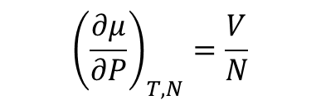
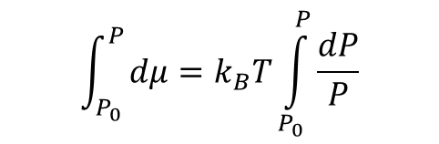

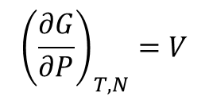



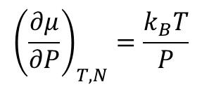


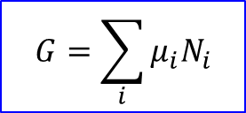

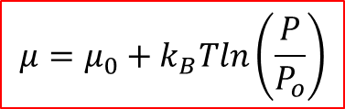
What about a system which have more than one type of particles?
As
$$G=μN$$
➔ $G=μ_{1}N_{1}+μ_{2}N_{2}+⋯$
$$G=\sum_{i}{μ_{i}N_{i}}$$
More on Chemical Potential
Since $μ=\frac{G}{N}$
➔ ${\left(\frac{∂μ}{∂P}\right)}_{T, N}=\frac{1}{N}{\left(\frac{∂G}{∂P}\right)}_{T, N}$
We already have
$${\left(\frac{∂μ}{∂P}\right)}_{T, N}=\frac{V}{N}$$
$${\left(\frac{∂G}{∂P}\right)}_{T, N}=V$$
For ideal gas, we have
$$PV=Nk_{B}T (OR nRT)$$
➔ $\frac{V}{N}=\frac{k_{B}T}{P}$
Therefore,
$${\left(\frac{∂μ}{∂P}\right)}_{T, N}=\frac{k_{B}T}{P}$$
➔ $dμ\left(T, P\right)= k_{B}T\frac{dP}{P}$
$$\int_{P_{0}}^{P}{dμ=k_{B}T\int_{P_{0}}^{P}{\frac{dP}{P}}}$$
$$μ=μ_{0}+k_{B}Tln\left(\frac{P}{P_{o}}\right)$$

Slide 10



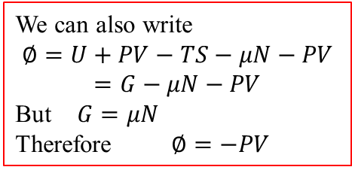
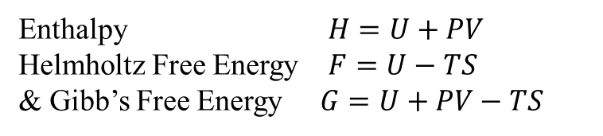





Landau or Grand Potential
Also called Grand Free Energy
We know
Enthalpy $H=U+PV$
Helmholtz Free Energy $F=U−TS$
& Gibb’s Free Energy $G=U+PV−TS$
In all these cases, we kept, N fixed
How about the processes, where N changes?
P 5.23
We need to define a new thermodynamic: potential: Grand Free Energy
$$∅=U−TS−μN$$
OR $∅=F−μN$
We can also write
$$∅=U+PV−TS−μN−PV=G−μN−PV$$
But $G=μN$
Therefore $∅=−PV$
➔ $d∅=dU−TdS−SdT−μdN−Ndμ$
➔ $d∅=(TdS−PdV+μdN)−TdS−SdT−μdN−Ndμ$
➔ $d∅=−PdV−SdT−Ndμ$
$$∅(V,T,μ)$$
$${P=−\left(\frac{∂∅}{∂V}\right)}_{T, μ}$$
$${S=−\left(\frac{∂∅}{∂T}\right)}_{V, μ}$$
$${N=−\left(\frac{∂∅}{∂μ}\right)}_{V, T}$$
How about if we define another potential $ψ=U+PV−μN$ ?

Slide 11
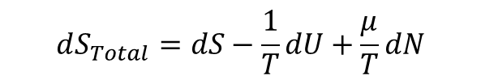
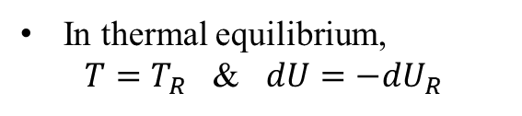

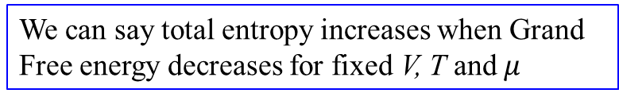


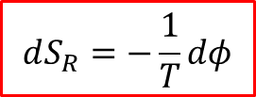
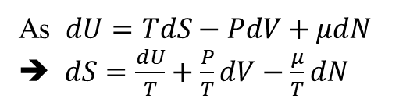
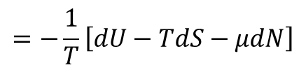
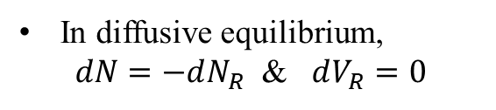
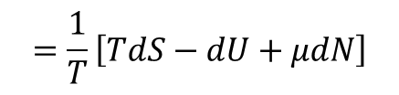
Thermo-Diffusive Equilibrium
with a reservoir that provides energy and particles
$$dS_{Total}=dS+dS_{R}$$
----- (1)
Where S = Entropy of the system
S_{R} = Entropy of the reservoir
As $dU=TdS−PdV+μdN$
➔ $dS=\frac{dU}{T}+\frac{P}{T}dV−\frac{μ}{T}dN$
In thermal equilibrium,
$T=T_{R}$ & $dU=−dU_{R}$
Therefore, $dS_{R}=\frac{dU_{R}}{T_{R}}+\frac{P}{T_{R}}dV_{R}−\frac{μ}{T_{R}}dN_{R}$
In diffusive equilibrium,
$dN=−dN_{R}$ & $dV_{R}=0$
➔ $dS_{R}=−\frac{1}{T}dU+\frac{μ}{T}dN$
----- (2)
As V_{R} is fixed
$$dS_{Total}=dS−\frac{1}{T}dU+\frac{μ}{T}dN$$
Eq (1) and (2) ➔
$$=\frac{1}{T}\left[TdS−dU+μdN\right]$$
$$=−\frac{1}{T}\left[dU−TdS−μdN\right]$$
$$dS_{R}=−\frac{1}{T}dφ$$
We can say total entropy increases when Grand Free energy decreases for fixed V, T and $μ$

Slide 12

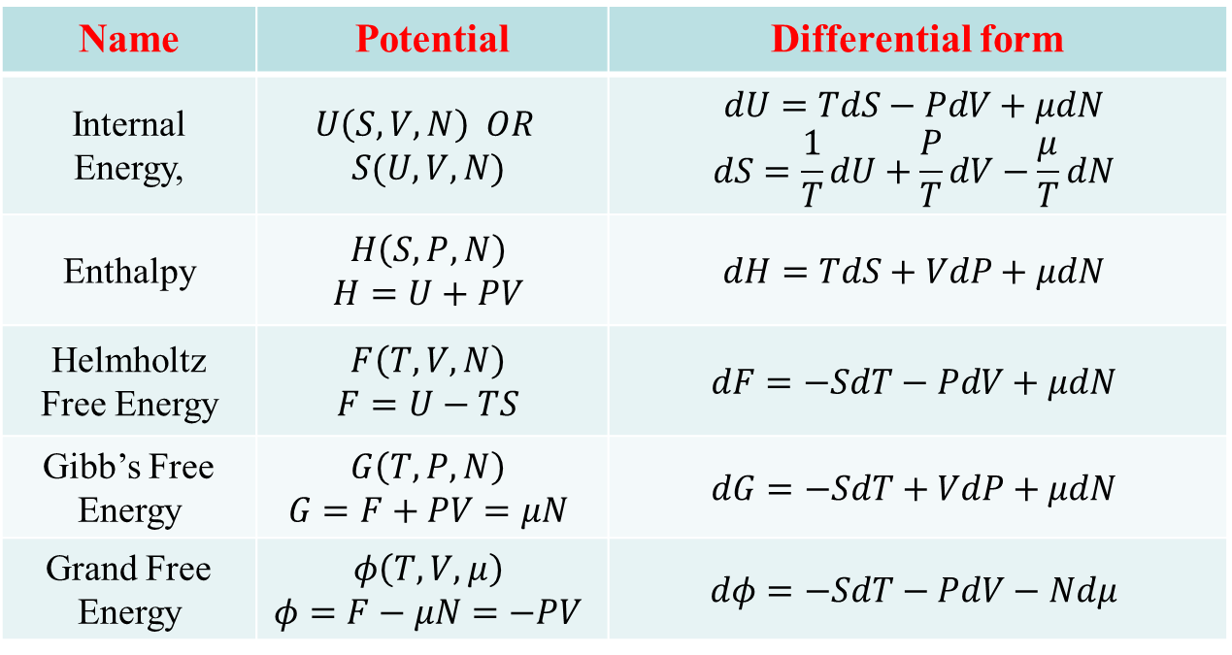
Summary of Important Thermodynamic Potentials and their natural variables
Name | Potential | Differential form
Internal Energy, | $$U\left(S, V, N\right) OR$$ $$S(U, V, N)$$ | $$dU=TdS−PdV+μdN$$ $$dS=\frac{1}{T}dU+\frac{P}{T}dV−\frac{μ}{T}dN$$
Enthalpy | $$H\left(S, P, N\right)$$ $$H=U+PV$$ | $$dH=TdS+VdP+μdN$$
Helmholtz Free Energy | $$F\left(T, V, N\right)$$ $$F=U−TS$$ | $$dF=−SdT−PdV+μdN$$
Gibb’s Free Energy | $$G\left(T, P, N\right)$$ $$G=F+PV=μN$$ | $$dG=−SdT+VdP+μdN$$
Grand Free Energy | $$φ\left(T, V, μ\right)$$ $$φ=F−μN=−PV$$ | $$dφ=−SdT−PdV−Ndμ$$
Also called Landau Potential, $Ω$

Slide 13
Assignment # 7 Due 4/1/2022
5.2, 5.5, 5.14, 5.16 & 5.22
Problems for practice of Ch 5:
5.1, 5.8, 5.10, 5.20, 5.23, 5.24, 5.25, 5.28, 5.32 (a, b), 5.35 and 5.47
Exam#2 Covering Ch 4 and 5
Wed 4/6/2022 ?

